Slide 1

Winter 2017-18
School of Mechanical and Building Sciences
MEE 1002 Engineering Mechanics
Module 7
Dynamics of Particles-Kinetics

Slide 2
Outline
Newton’s Second Law
Work-Energy
Impulse-Momentum

Slide 3
Newton’s Second Law

Slide 4
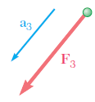



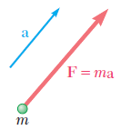


Newton’ Second Law
If the resultant force acting on a particle is not zero, the particle will have an acceleration proportional to the magnitude of the resultant and in the direction of this resultant force

Slide 5

Rectangular Components

Slide 6
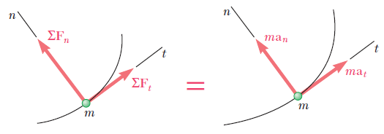


Tangential and Normal Components
Resolving the forces and the acceleration of the particle into components along the tangent to the path (in the direction of motion) and the normal (toward the inside of the path)

Slide 7
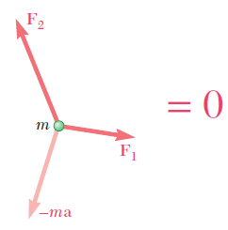

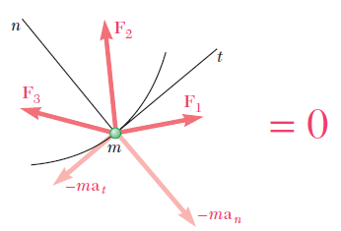
Dynamic Equilibrium
The tangential component of the inertia vector provides a measure of the resistance the particle offers to a change in speed
The normal component (also called centrifugal force) represents the tendency of the particle to leave its curved path

Slide 8
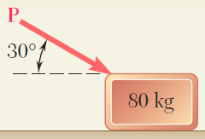
Problem-1
A 80 kg block rests on a horizontal plane. Find the magnitude of the force P required to give the block an acceleration of 2.5 m/s² to the right. The coefficient of kinetic friction between the block and the plane is μ_{k} = 0.25.
P = 535 N

Slide 9
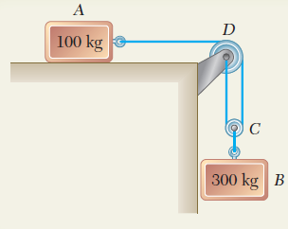




Problem-2
The two blocks shown start from rest. The horizontal plane and the pulley are frictionless, and the pulley is assumed to be of negligible mass. Determine the acceleration of each block and the tension in each cord.
$$a_{A}=8. 4 m/s^{2}$$
$$a_{B}=4.2 m/s^{2}$$
$$T_{1}=840 N$$
$$T_{2}=1680 N$$

Slide 10
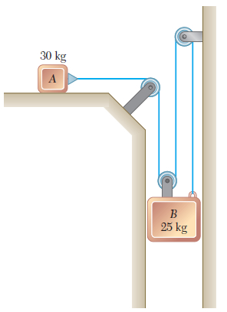
Problem-3 (a)
The two blocks shown are originally at rest. Neglecting the masses of the pulleys and the effect of friction in the pulleys and between block A and the horizontal surface, determine (a) the acceleration of each block, (b) the tension in the cable.
(a) a_{A}= 2.49 m/s², a_{B} = 0.831 m/s² (b) T = 74.8 N

Slide 11
Problem-3 (b)
The two blocks shown are originally at rest. Neglecting the masses of the pulleys and the effect of friction in the pulleys and assuming that the coefficients of friction between block A and the horizontal surface are μ_{s} = 0.25 and μ_{k} = 0.20, determine (a) the acceleration of each block, (b) the tension in the cable.
(a) a_{A}= 0.698 m/s², a_{B} = 0.233 m/s² (b) T = 79.8 N

Slide 12
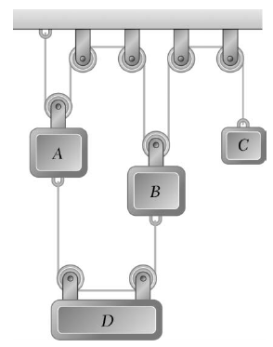



Problem-4
The masses of blocks A, B, C and D are 9 kg, 9 kg, 6 kg and 7 kg, respectively. Knowing that a downward force of magnitude 120 N is applied to block D, determine (a) the acceleration of each block, (b) the tension in cord ABC. Neglect the weights of the pulleys and the effect of friction.

Slide 13
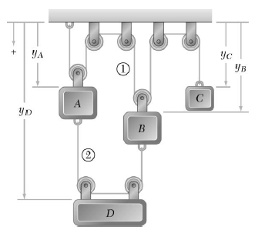
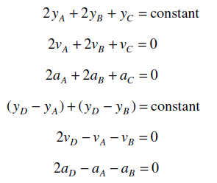
Solution

Slide 14
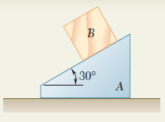
Problem-5
The 6-kg block B starts from rest and slides on the 15-kg wedge A, which is supported by a horizontal surface. Neglecting friction, determine (a) the acceleration of the wedge, (b) the acceleration of the block relative to the wedge.
a_{A}=+1.545 m/s²
a_{B/A}=+6.24 m/s²

Slide 15
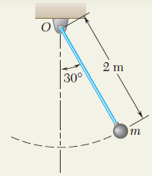



Problem-6
The bob of a 2-m pendulum describes an arc of circle in a vertical plane. If the tension in the cord is 2.5 times the weight of the bob for the position shown, find the velocity and the acceleration of the bob in that position.
$$a_{t}=4.9 m/s^{2}$$
$$a_{n}=16.03 m/s^{2}$$
$$v=±5.66 m/s$$

Slide 16
Work-Energy Principle

Slide 17
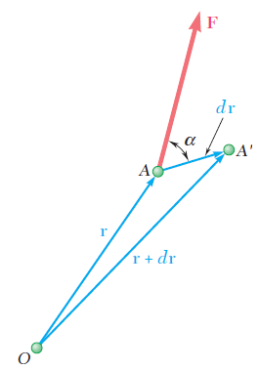



Work of a Force
The advantage of these methods lies in the fact that they make the determination of the acceleration unnecessary
Method of work and energy directly relates force, mass, velocity, and displacement
The work of the force F corresponding to the displacement dr is defined as
Denoting by F and ds respectively, the magnitudes of the force and of the displacement, and by α the angle formed by F and dr

Slide 18
The work dU is positive if the angle α is acute and negative if α is obtuse
If the force F has the same direction as dr (α=0°), the work dU reduces to F ds
If F has a direction opposite to that of dr (α=180°), the work is dU = -F ds
If F is perpendicular to dr (α=90°), the work dU is zero

Slide 19
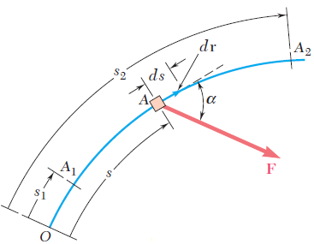



Work of F during a Finite Displacement
When the force F is defined by its rectangular components

Slide 20
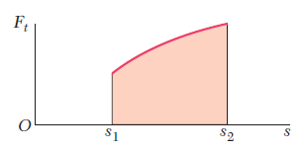
The variable of integration s measures the distance travelled by the particle along the path
The work U₁₋₂ is represented by the area under the curve obtained by plotting F_{t} = F cos α against s

Slide 21
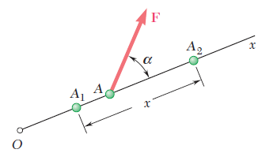

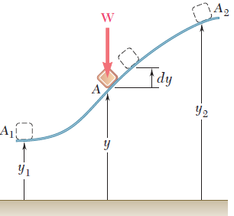
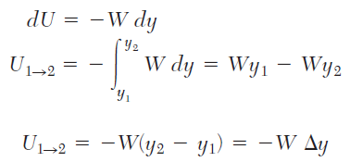
Work of a Constant Force in Rectilinear Motion
Work of the Force of Gravity

Slide 22
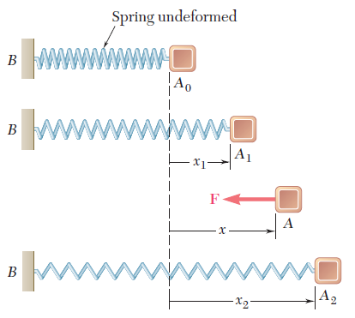

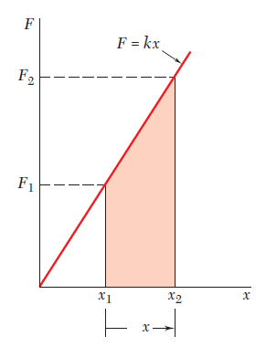
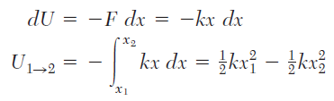


Work of the Force Exerted by a Spring
$$∆$$

Slide 23
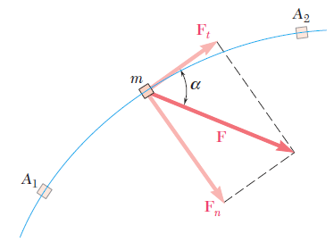

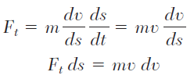




Principle of Work and Energy

Slide 24
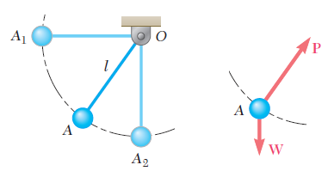



Application of the Principle
P does no work, since it is normal to the path
The only force which does work is thus the weight W
Work done,
Kinetic energy,

Slide 25

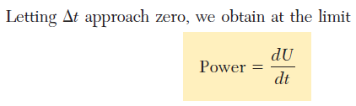



Power and Efficiency
Power is defined as the time rate at which work is done
If ΔU is the work done during the time interval Δt, then the average power during that time interval is

Slide 26
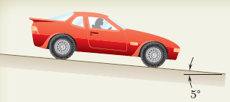
Problem 1
An automobile weighing 1000 kg is driven down a 5° incline at a speed of 72 km/h when the brakes are applied, causing a constant total braking force (applied by the road on the tires) of 5000 N. Determine the distance travelled by the automobile as it comes to a stop.
x=48.25 m

Slide 27
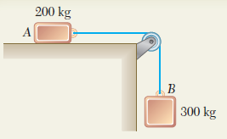
Problem 2
Two blocks are joined by an inextensible cable as shown. If the system is released from rest, determine the velocity of block A after it has moved 2 m. Assume that the coefficient of kinetic friction between block A and the plane is 0.25 and that the pulley is weightless and frictionless.
v=4.43 m/s

Slide 28
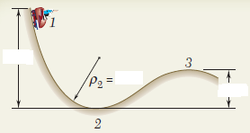
Problem 3
A 1000-kg car starts from rest at point 1 and moves without friction down the track shown. (a) Determine the force exerted by the track on the car at point 2, where the radius of curvature of the track is 6 m. (b) Determine the minimum safe value of the radius of curvature at point 3.
12 m
(a) N = 49.03 kN
6 m
4.5 m
(b) ρ = 15 m

Slide 29

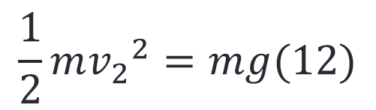

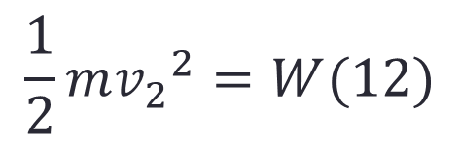


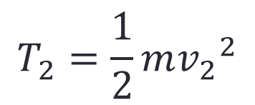

a) Force Exerted by the track at point 2
$$T_{2}=\frac{1}{2}m{v_{2}}^{2}$$
$$T_{1}=0$$
The only force does work is the weight W
$$U_{1−2}=+W(12)$$
Using the principle of work and energy
$$T_{1}+U_{1−2}=T_{2}$$
$$\frac{1}{2}m{v_{2}}^{2}=W(12)$$
$$\frac{1}{2}m{v_{2}}^{2}=mg(12)$$
$$v_{2}=15.34 m/s$$

Slide 30
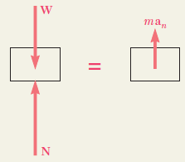

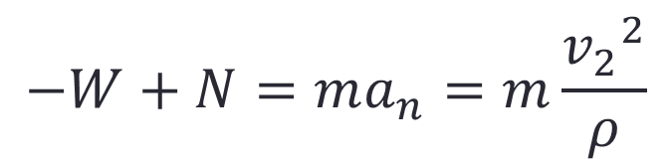
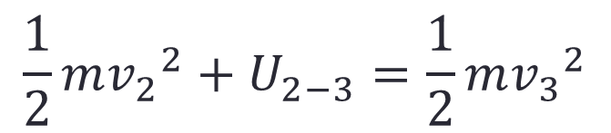

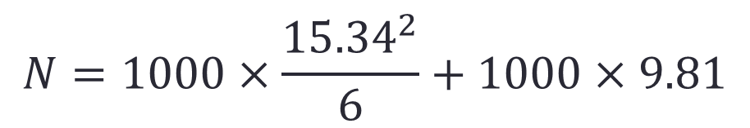
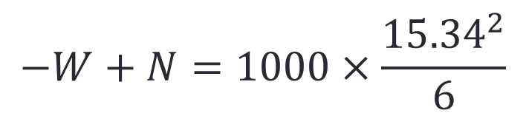
Newton’s second law at point 2
$$−W+N=ma_{n}=m\frac{{v_{2}}^{2}}{ρ}$$
$$−W+N=1000×\frac{{15.34}^{2}}{6}$$
$$N=1000×\frac{{15.34}^{2}}{6}+1000×9.81$$
$$N=49.03 kN$$
b) Minimum value of ρ at point 3
$$T_{2}+U_{2−3}=T_{3}$$
$$\frac{1}{2}m{v_{2}}^{2}+U_{2−3}=\frac{1}{2}m{v_{3}}^{2}$$

Slide 31
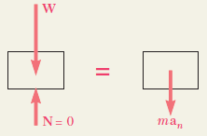

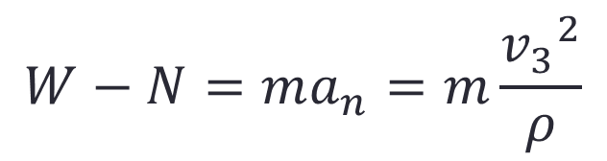

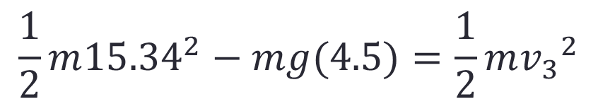

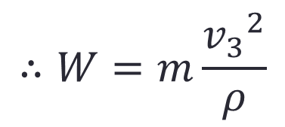
$$\frac{1}{2}m{15.34}^{2}−mg(4.5)=\frac{1}{2}m{v_{3}}^{2}$$
$${15.34}^{2}−9.81(9)={v_{3}}^{2}$$
$$v_{3}=12.13 m/s$$
Newton’s second law at point 3
$$W−N=ma_{n}=m\frac{{v_{3}}^{2}}{ρ}$$
For minimum value of ρ, N=0
$$∴W=m\frac{{v_{3}}^{2}}{ρ}$$
$$ρ=15 m$$

Slide 32
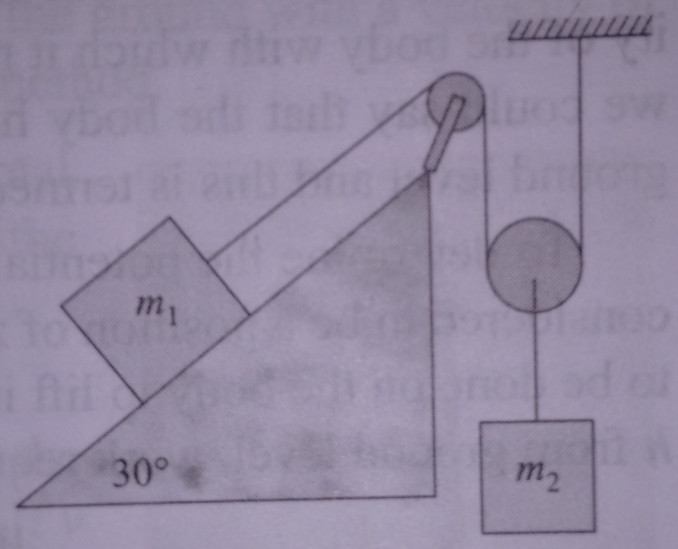
Problem 4
In the system of blocks shown, if m₁ = 3 kg and m₂ = 5 kg, determine the velocities of the blocks after the block of mass m₂ displaces by 2 m. Take μ= 0.15.
v₁ = 3.36 m/s
v₂ = 1.68 m/s

Slide 33
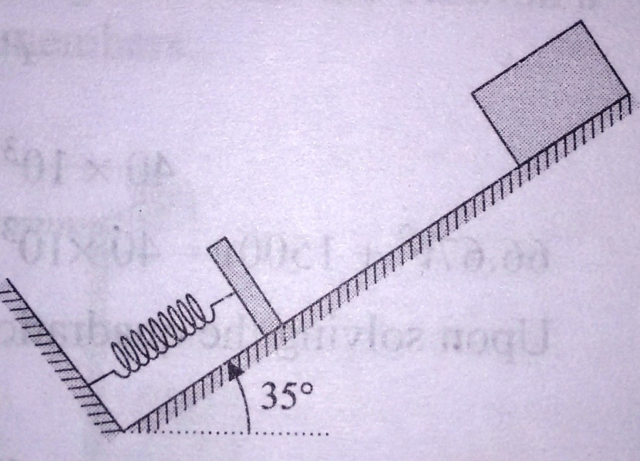
Problem 5
A block of 10 kg mass slides down an inclined plane with a slope angle of 35°. It is stopped by a spring of stiffness 1 kN/m. If the block slides down 5 m before hitting the spring then determine the maximum compression of the spring. The coefficient of friction between the block and the inclined plane is 0.15.
s = 0.711 m

Slide 34
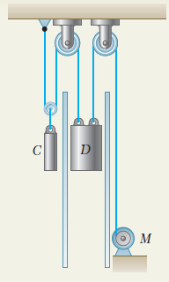
Problem 6
The dumbwaiter D and its load have a combined weight of 300 kg, while the counterweight C weighs 400 kg. Determine the power delivered by the electric motor M when the dumbwaiter (a) is moving up at a constant speed of 2.5 m/s, (b) has an instantaneous velocity of 2.5 m/s and an acceleration of 1 m/s², both directed upward.

Slide 35

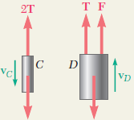






Uniform Motion (a=0)
$$Power, P=Fv_{D}$$
From free body C,
$$2T−400g=0$$
From free body D,
$$F+T−300g=0$$
$$F=981 N$$
400 g
300 g
$$P=981×2.5$$
$$P=2450 W$$

Slide 36
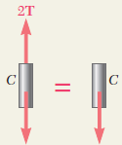
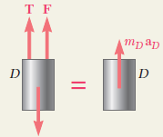









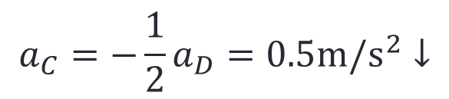

b) Uniformly Accelerated Motion
$$a_{C}=−\frac{1}{2}a_{D}=0.5m/s^{2}↓$$
$$a_{D}=1 m/s^{2}↑$$
From free body C,
$$+↓ΣF_{y}={m_{C}a}_{C}$$
$$400g−2T=400 (0.5)$$
$$T=1862 N$$
400 g
$${m_{C}a}_{C}$$
From free body D,
$$+↑ΣF_{y}={m_{D}a}_{D}$$
$$F+T−300g=300(1)$$
$$F=1381 N$$
$$P=1381×2.5$$
$$P=3450 W$$
300 g

Slide 37



Potential Energy

Slide 38
Impulse-Momentum Principle

Slide 39

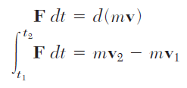


Impulse and Momentum
This method can be used to solve problems involving force, mass, velocity, and time.
where mv is the linear momentum of the particle
The integral is a vector known as the linear impulse, or simply the impulse of the force F during the interval of time considered.

Slide 40
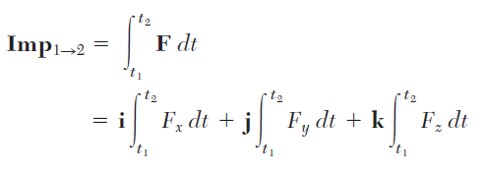



Rectangular Components
The components of the impulse of the force F are, respectively, equal to the areas under the curves obtained by plotting the components F_{x}, F_{y}, and F_{z} against t.

Slide 41



In the case of a force F of constant magnitude and direction, the impulse is represented by the vector F(t₂ - t₁), which has the same direction as F
when a particle is acted upon by a force F during a given time interval, the final momentum mv₂ of the particle can be obtained by adding vectorially its initial momentum mv₁ and the impulse of the force F during the time interval considered

Slide 42


To obtain an analytic solution, it is expressed by the corresponding component equations
When several forces act on a particle, the impulse of each of the forces must be considered

Slide 43


When a problem involves two particles or more
If no external force is exerted on the particles or, more generally, if the sum of the external forces is zero
The total momentum of the particles is conserved

Slide 44

Impulsive Motion
A force acting on a particle during a very short time interval that is large enough to produce a definite change in momentum is called an impulsive force and the resulting motion is called an impulsive motion
Nonimpulsive forces include the weight of the body, the force exerted by a spring, or any other force which is known to be small compared with an impulsive force
Unknown reactions may or may not be impulsive; their impulses should therefore be included as long as they have not been proved negligible

Slide 45


In the case of the impulsive motion of several particles
If all the external forces acting on the various particles are nonimpulsive

Slide 46

Problem 1
An automobile weighing 1800 kg is driven down a 5° incline at a speed of 100 km/h when the brakes are applied, causing a constant total braking force (applied by the road on the tires) of 7000 N. Determine the time required for the automobile to come to a stop.
t = 9.16 s

Slide 47




Solution
$$mv_{1}+Σ{Imp}_{1−2}=mv_{2}$$
$$mv_{1}+\left(W\sin{5°}\right)t−Ft=0$$
1800$×27.32+\left(1800×9.81\sin{5°}\right)t−7000t=0$
$$t=9 seconds$$

Slide 48


Problem 2
A 120-g baseball is pitched with a velocity of 24 m/s toward a batter. After the ball is hit by the bat B, it has a velocity of 36 m/s in the direction shown. If the bat and ball are in contact 0.015 s, determine the average impulsive force exerted on the ball during the impact.
F_{y}= +412.6 kN
36 m/s
F_{x}= +185.1 kN
F= 452 kN
24 m/s

Slide 49




Solution
$$mv_{1}+Σ{Imp}_{1−2}=mv_{2}$$
x- component
$$−mv_{1}+F_{x}t=mv_{2}\cos{40°}$$
$$−120×24+F_{x}×0.015=120×36\cos{40°}$$
$$F_{x}=412.6 kN$$

Slide 50




y- component
$$0+F_{y}t=mv_{2}\sin{40°}$$
$$0+F_{y}×0.015=120×36×\sin{40°}$$
$$F_{y}=185.1 kN$$
$$F=\sqrt{{F_{x}}^{2}+{F_{y}}^{2} }$$
$$F=452 kN$$

Slide 51

Problem 3
A 10-kg package drops from a chute into a 25-kg cart with a velocity of 3 m/s. Knowing that the cart is initially at rest and can roll freely, determine (a) the final velocity of the cart, (b) the impulse exerted by the cart on the package, (c) the fraction of the initial energy lost in the impact.
(a) v₂ = 0.742 m/s
(b)
(c) The fraction of energy lost = 0.786

Slide 52


Solution

Slide 53


Slide 54


